Slide 1

Stores Sales Prediction -iNeuron Internship
By Derrick T

Slide 2
Problem Statement:
Nowadays, shopping malls and Big Marts keep track of individual item sales data in order to forecast future client demand and adjust inventory management. In a data warehouse, these data stores hold a significant amount of consumer information and particular item details. By mining the data store from the data warehouse, more anomalies and common patterns can be discovered.
Approach: The classical machine learning tasks like Data Exploration, Feature Engineering, Model Building and Model Testing. Try out different machine learning algorithms that’s best fit for the above case.
Results: To build a solution that should able to predict the sales of the different stores of Big Mart according to the provided dataset.

Slide 3
Dataset:
We have train (8523) and test (5681) data set, train data set has both input and output variable(s). We need to predict the sales for test data set. >>Item Identifier: Unique product ID >>Item_Outlet_Sales: Sales of the product in the particular store. This is the outcome variable to be predicted.<<
Item_Weight: Weight of product
Item_Fat_Content: Whether the product is low fat or not
Item_Visibility: The % of total display area of all products in a store allocated to the
particular product
Item_Type: The category to which the product belongs
Item_MRP: Maximum Retail Price (list price) of the product
Outlet_Identifier: Unique store ID
Outlet_Establishment_Year: The year in which store was established
Outlet_Size: The size of the store in terms of ground area covered
Outlet_Location_Type: The type of city in which the store is located
Outlet_Type: Whether the outlet is just a grocery store or some sort of supermarket

Slide 4

Details
The propose solution is building a machine model that is trained using past data and evaluated, and the final evaluated model is fed in the unseen data to make predictions, in this case the sales amount is predicted.
There were no technical requirements for developing this solution, the default requirements were a Personal Computer with good computing power.
The data required was based on the problem statement and the variables or the dependencies provided. The client provides the dataset with relevant columns as mentioned in the problem statement. After the solution is developed, user data of the user’s choice will be required.

Slide 5
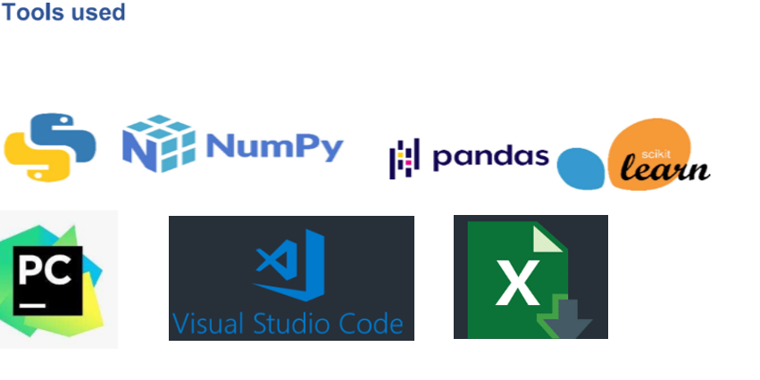
Tools Used

Slide 6
Contd.
Python was used as the programming language – to load, pre-process, scale, build ML model and for saving it.
For visualization, data wrangling etc, frameworks such as NumPy, pandas, matplotlib, scikit learn were used
PyCharm was used as the IDE for developing a flask application.
Jupyter notebook as the IDE for developing the solution.
Visual Studio Code to develop a webpage using HTML and CSS.

Slide 7
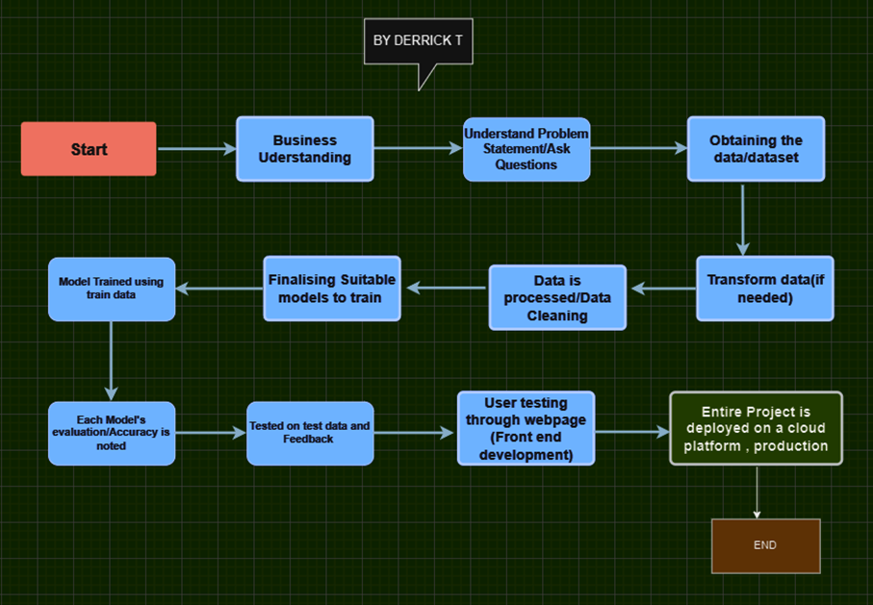
Process Flow

Slide 8
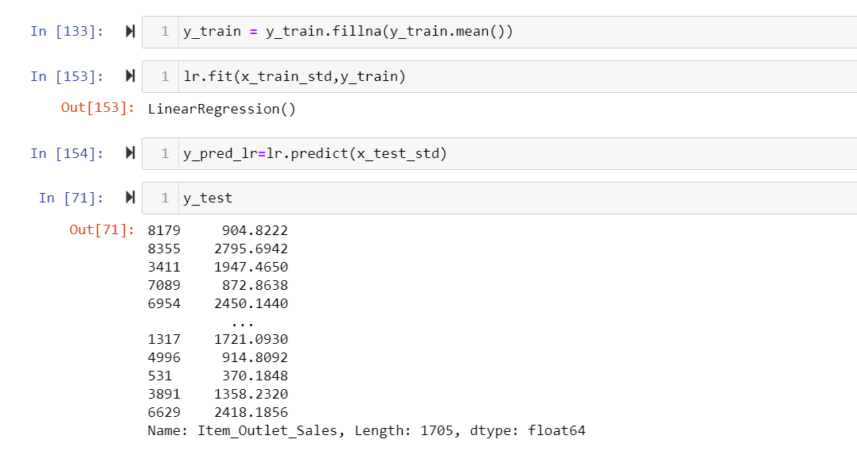
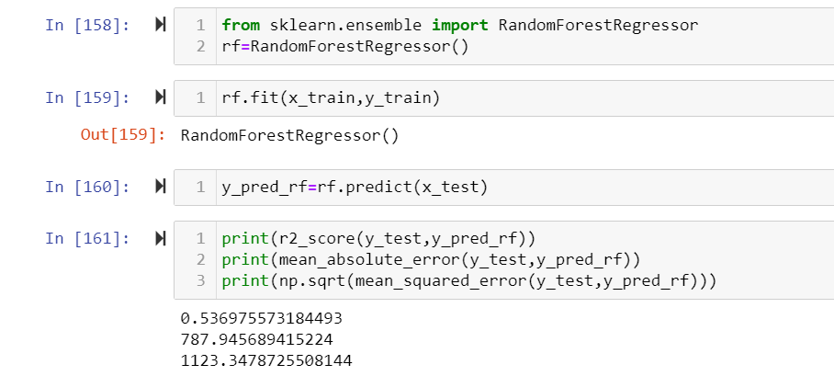
Model:

Slide 9
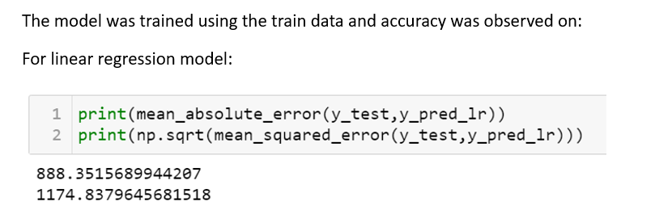
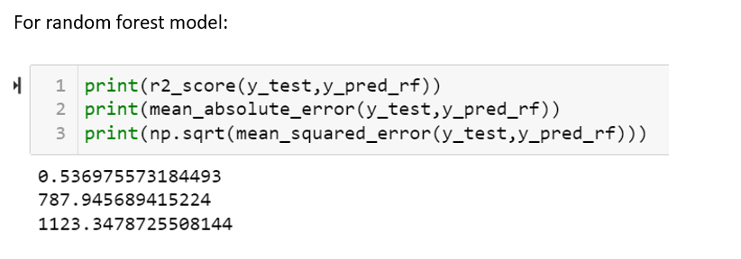
Model:

Slide 10
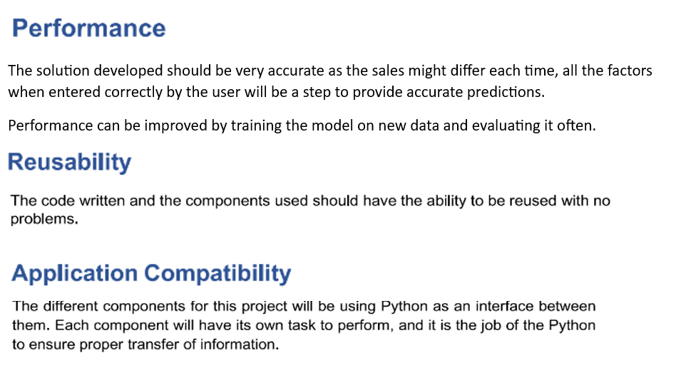

Slide 11
Random Forest model provided more accuracy than linear regression model.
From this , we can conclude that this model can be used as a sales improving technique by forecasting sales for different product aspects and plan a business model accordingly.

